Slide 1
Dillingham Construction International Inc. (DCII)
An international construction company focused on the most technical challenges
Specializes in building complex structures and in installing sophisticated computerized systems
Provides general construction, design/build, and construction management for commercial, industrial, heavy civil and marine clients throughout the world
DCII has completed many projects that have enhanced the lives of the citizens of Turkey, and around the world
“Improving the world one project at a time!”

Slide 2
Building the Izmir-Aydın Motorway and Izmir Ring Road
“Improving the world
one project at a time!”
- Constructing an improved world based on global engineering and construction expertise from an environmentally conscious perspective
- Advanced Technology
- Meeting Technical Challenges

Slide 3
A Trusted Partner of TCK (Türkİye cumhuriyetİ karayolları “tck”— Turkısh Republıc Department of motorways)

Slide 4
$1.06 Billion in New Roadways For Turkey’s Future
Located in the Beautiful and Growing Aegean Region of Turkey
Completed in 2014
“Improving the world one project at a time!”

Slide 5
Part of the Trans-European Road Network
The Izmir Ring Road Motorway project consists of the 54 km Ring Road and the 96 km Izmir-Aydın Motorway.
Three lanes in each direction, secondary roads, junctions, and directional arms, which total 333 km of road construction.
“Improving the world one project at a time!”

Slide 6
Technical Challenges Met
Dillingham, with its Turkish partner designed and built a median-divided, grade-separated, limited access toll highway, which included:
3 Major tunnels
24 Major Interchanges
97 Bridges
31 Underpasses
9 Viaducts
5 Toll complexes
A 16,000 m² Administrative Complex
6 Maintenance service areas
“Improving the world one project at a time!”

Slide 7
Izmir Ring Road

Slide 8
- 1. karşıyaka tunnel: 268 meters - 2. karşıyaka tunnel: 1,824 meters
A TOTAL OF 2,092 meters of three-lane tunnels:
“Improving the world one project at a time!”

Slide 9
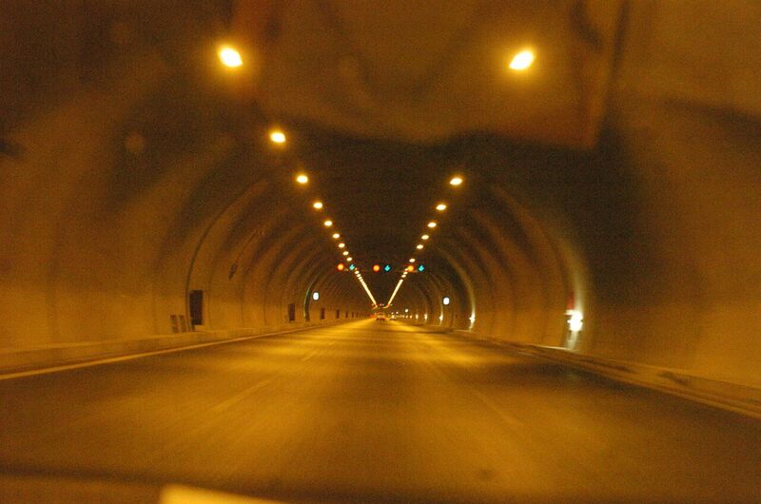

Slide 10
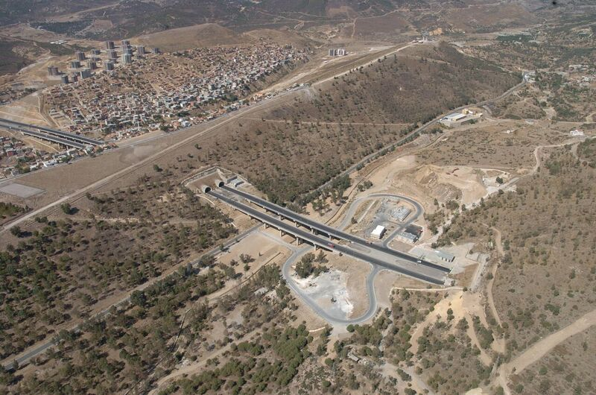
KARŞIYAKI tünelLERi

Slide 11
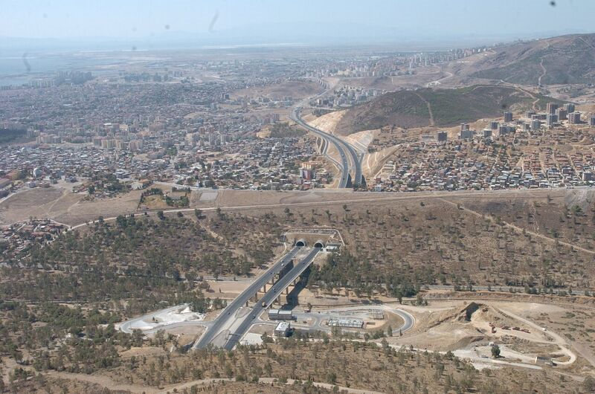

Slide 12
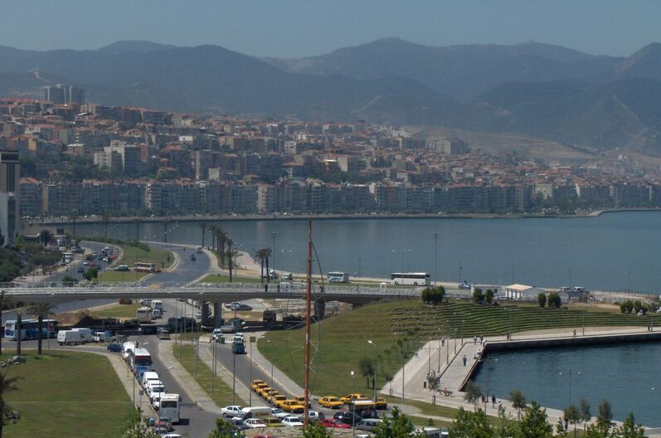

Slide 13
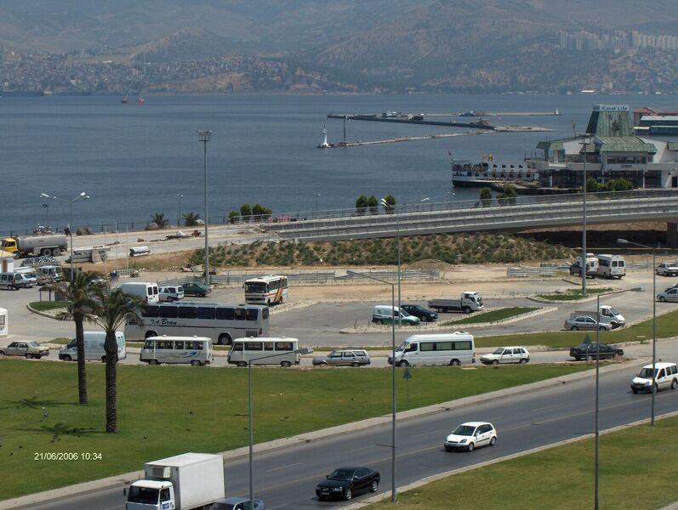

Slide 16
Izmir-Aydın Motorway

Slide 17
- SELATTİn tunnel: 6,061 Meters - 2 parallel tubes inter-connected by - 6 transverse passages for pedestrian transit in case of emergencies.
A TOTAL OF 6,061 meters of three-lane tunnels:
“Improving the world one project at a time!”

Slide 19
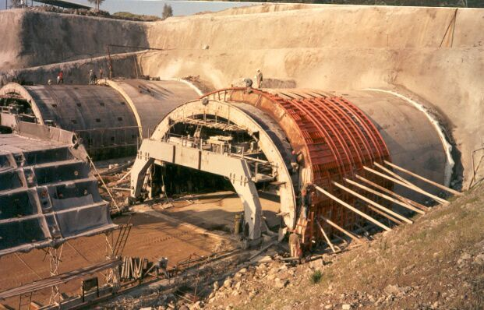

Slide 20
Selatİn tüneli
Selatİn tunnel: two tubes
each 3.2 Kms long
Each three lanes wide
New standard for all of europe

Slide 25
7 bridges - totaling more than 3,600 meters in length
“Improving the world one project at a time!”

Slide 26
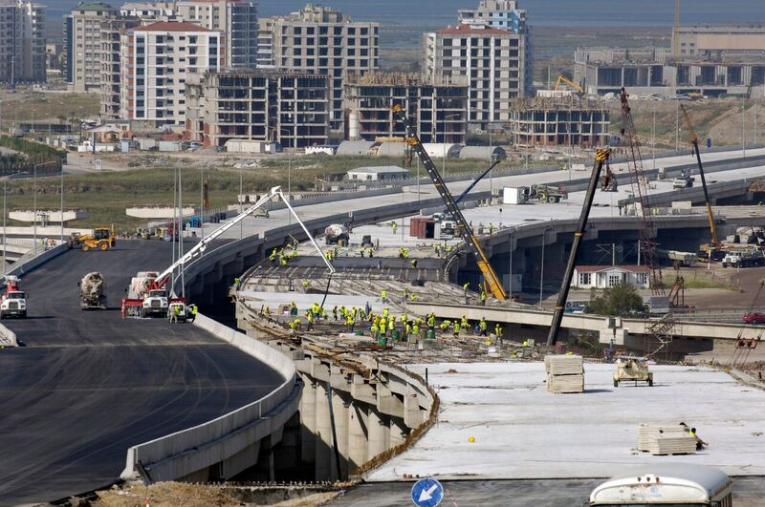

Slide 27
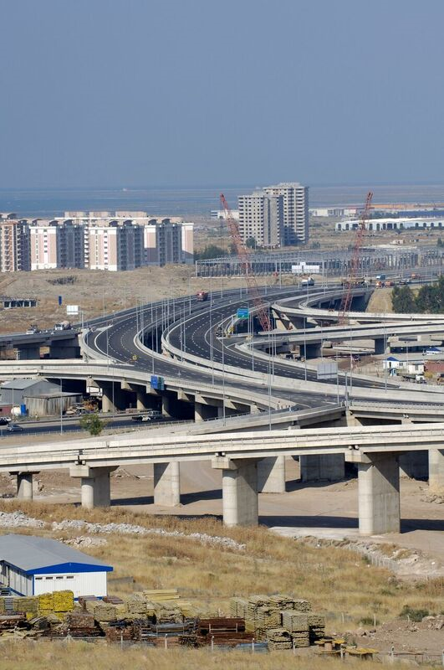

Slide 30
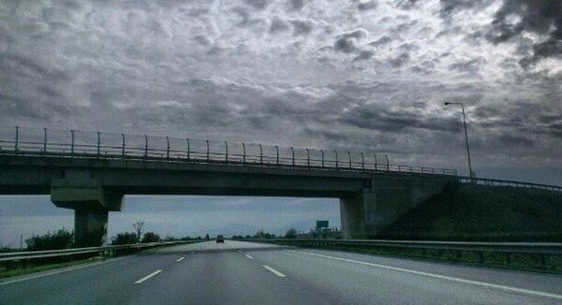

Slide 32
24 interchanges totaling 1,414 meters in length
“Improving the world one project at a time!”

Slide 33
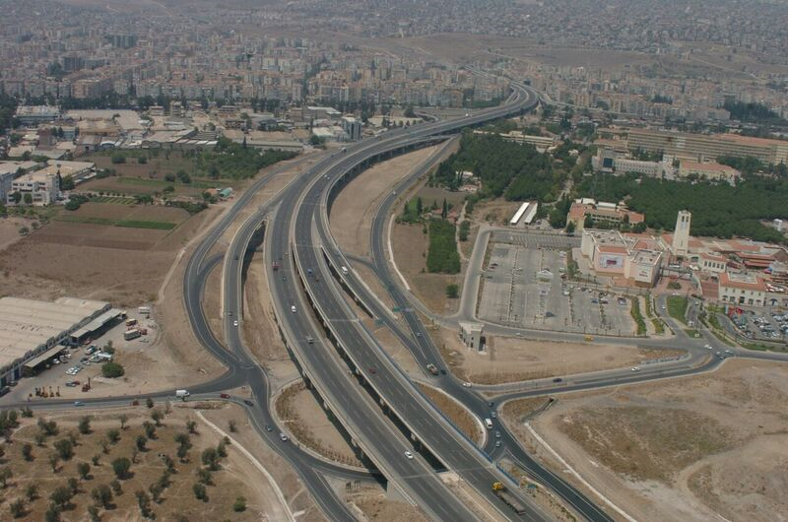

Slide 38
Over 40 KILOMERS of viaducts, Culverts and Water Management
“Improving the world one project at a time!”

Slide 40
“Improving the world one project at a time!”
What Technical Challenges Can We Help You Solve Today?

Slide 41
Contact Us
www.dcintinc.com
580-366-2552
Overseas: +90-533-730-0622
Email: gildhousev@dcintinc.com
Verndell H. Gildhouse
“Improving the world one project at a time!”

